Slide 1
ncRNAs in cancer

Slide 2
Lecture plan
The world of non-coding RNAs – short introduction
lncRNAs, siRNAs and other ncRNA in cancer
piRNAs – guardians of the genome
miRNAs – biogenesis and role in cancer
Special case of miR-34a
siRNA nanomedicine

Slide 3
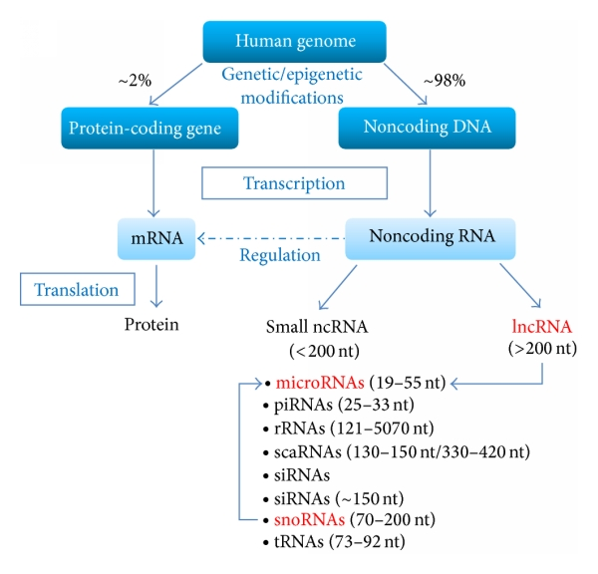
I. The World of non-coding RNAs
Broadly refers to the RNA molecules that do not encode any protein
Noncoding RNAs as novel biomarkers in prostate cancer. Rönnau CG, Verhaegh GW, Luna-Velez MV, Schalken JA. Biomed Res Int. 2014;2014:591703

Slide 4
I. The World of non-coding RNAs
Broadly refers to the RNA molecules that do not encode any protein
ncRNAs
microRNAs
siRNAs
Small RNAs
(snoRNAs, snRNAs, piRNAs etc.)
Medium and large RNAs
~18-25nt
Regulation of gene
expression
~20-300nt
Modification of target RNAs
Synthesis of telomeric DNA,
Chromatin structure
Transcription modulation
Nuclear structure and dynamics
Gametogenes
Over 300nt
Imprinting
X-inactivation
Transcription
Precursors of other
small RNAs

Slide 5
Various ncRNAs in human cells
Imprinting
Xist/Tsix RNAs
Stability
Telomerase RNA
DNA
Telomere
Editing
gRNA
Transcription regulation
Long ncRNA, siRNA,
piRNA, 75K RNA
pre-rRNA
pre-mRNA
Modification
snoRNA
Nucleus
Splicing
snRNA
Ψ
Ψ
mRNA
Ψ
Nucleolus
snRNA
ER
snoRNA
scaRNA
rRNA
Posttranscriptional
regulation
miRNA, siRNA
Transport
SRP RNA
mRNA
Cytoplasm
Translation
rRNA, tRNA, tRF
Modification
RNaseP, snoRNA
The main groups of ncRNAs and their possible role in a human cell. The shaded boxes represent different functional groups of ncRNAs, each of them combines several groups from NONCODE classification. snoRNA and RNaseP are non-coding RNAs that modify other ncRNAs.

Slide 6
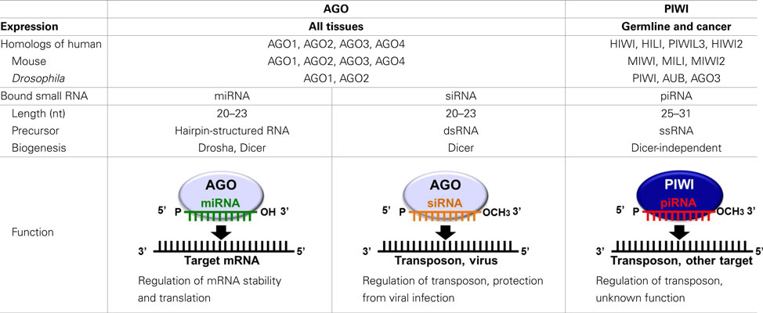
Overview of miRNA/siRNA/piRNA

Slide 7
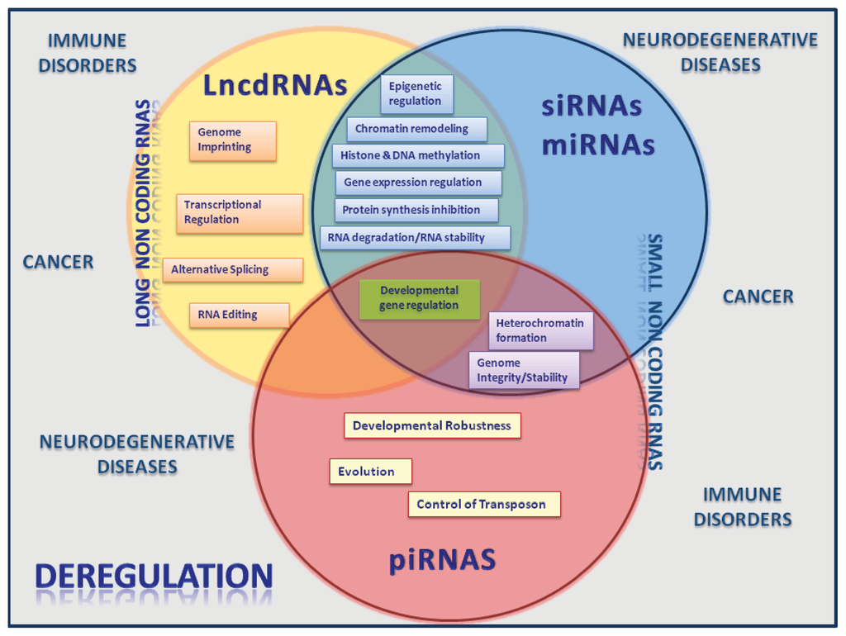
Disbalance of ncRNA expression is associated with various diseases

Slide 8
II. lncRNA, sndRNA, tRNA-derived fragments (tRFs) and siRNA in cancer

Slide 9
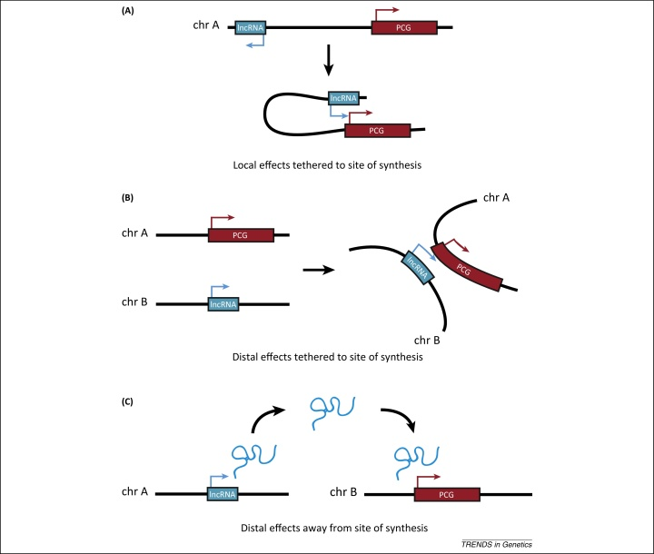
Types of lncRNAs
LncRNAs represent a diverse class of modestly conserved, polyadenylated, non-protein-coding RNAs with essential roles in tumorigenesis.
LncRNAs comprise, among others, long intergenic non-coding RNAs (lincRNAs) and natural antisense transcripts (NATs).
Yao Y, Li J, Wang L. Large intervening non-coding RNA HOTAIR is an indicator of poor prognosis and a therapeutic target in human cancers. Int J Mol Sci. 2014 Oct 20;15(10):18985-99. doi: 10.3390/ijms151018985.

Slide 10
Cancer-related lncRNAs
Cancer Type | lncRNA | Function | Reference
Breast cancer | HOTAIR | Chromatin remodeling | [11,30]
 | ANRIL | Chromatin remodeling | [27,28,29]
 | MALAT1 | Gene relocation, scaffold, alternative splicing | [4,10]
Colorectal cancer | HOTAIR | Chromatin remodeling | [11,13]
 | HULC | Liver metastasis | [23]
 | MALAT1 | Gene relocation, scaffold, alternative splicing | [7]
Hepatocellular carcinoma | MALAT1 | Gene relocation, scaffold, alternative splicing | [4]
 | HULC | MiRNA sponge | [23]
 | HOTAIR | Chromatin remodeling | [31]
 | H19 lncRNA | Promoting tumor growth | [25]
Yao Y, Li J, Wang L. Large intervening non-coding RNA HOTAIR is an indicator of poor prognosis and a therapeutic target in human cancers. Int J Mol Sci. 2014 Oct 20;15(10):18985-99. doi: 10.3390/ijms151018985.

Slide 11
HOTAIR lncRNA
Trithorax and Polycomb are antagonistic groups of proteins that help to “open” or “close” the chromatin, respectively.
EZH2 is a member of PRC2 (Polycomb Repressive Complex 2) that methylates H3K27, repressing the chromatin
BRCA1 is a DNA repair protein and a negative modulator of the PRC2 complex.
EZH2 contains two overlapping binding regions for the BRCA1 and the HOTAIR; BRCA1 inhibits the binding of EZH2 to HOTAIR.
HOTAIR induces genome-wide re-targeting of PRC2 and an altered gene expression pattern, promoting tumorigenesis and tumor progression
HOTAIR interacts with and recruits PRC2 and regulates the chromosome occupancy of EZH2 (a subunit of PRC2), which leads to histone H3 lysine 27 trimethylation of the HOXD locus (homeostasis controlling genes).
Moreover, HOTAIR can trigger the epithelial-mesenchymal transition (EMT) and interact with other small RNAs.
Yao Y, Li J, Wang L. Large intervening non-coding RNA HOTAIR is an indicator of poor prognosis and a therapeutic target in human cancers. Int J Mol Sci. 2014 Oct 20;15(10):18985-99.

Slide 12
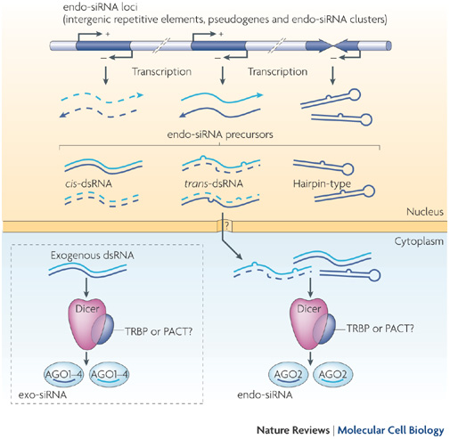
siRNA biogenesis
Only very few siRNAs were shown to be differentially expressed in cancers.

Slide 13
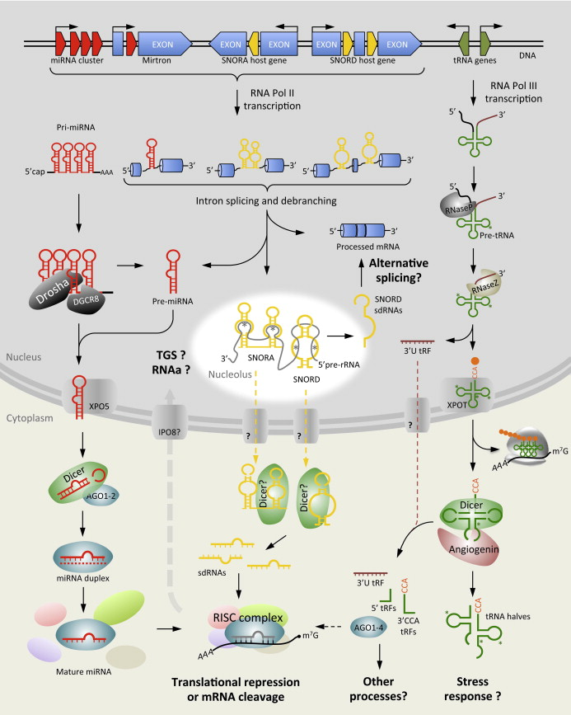
sndRNA (sdRNA) biogenesis
SnoRNAs associate with small nucleolar ribonucleoprotein particles (snoRNP) and serve as guide molecules for the snoRNPs in the post-transcriptional modification of ribosomal RNA (rRNA) and small nuclear RNA (snRNA).
sno-derived RNAs (sdRNAs) from H/ACA snoRNAs are predominantly 20–24 nucleotides (nt)
Martens-Uzunova ES, Olvedy M, Jenster G. Beyond microRNA--novel RNAs derived from small non-coding RNA and their implication in cancer. Cancer Lett. 2013 Nov 1;340(2):201-11. doi: 10.1016/j.canlet.2012.11.058.

Slide 14
sndRNA (sdRNA) in cancer
sdRNA demonstrates miRNA-like activity
miRNAs and snoRNAs share ancestral origins and that miRNAs may have evolved from ancient snoRNAs via retrotransposition
SNORD-sdRNAs may function as regulators of alternative splicing
sdRNAs may function as tumor suppressors and oncogenes
Several sdRNAs were found disregulated in pancreatic cancer (Müller et al. 2015 Next-generation sequencing reveals novel differentially regulated mRNAs, lncRNAs, miRNAs, sdRNAs and a piRNA in pancreatic cancer. Mol Cancer. 2015 Apr 25;14(1):94.)
At present, it remains to be discovered whether the altered expression of sdRNAs and/or their snoRNA precursors in cancer is the result of a specific process or of more general defects in cellular metabolism caused by malignant transformation and cancer progression.

Slide 15
tRNA fragments (tRF)
Also known as tRNA halves, tRNA-derived halves, tRNA-derived RNA fragments (tRFs), stress-induced tRNA-derived small RNAs (tiRNAs), tRNA-derived small RNAs (tsRNAs) or urinary bladder carcinoma RNAs (ubcRNAs).
According to recent nomenclature, tRNA fragments can be separated in two major classes: tRNA halves and small tRNA fragments (tRFs)
(Sobala and Hutvagner Transfer RNA-derived fragments: origins, processing, and functions Wiley Interdiscipl. Rev.: RNA, 2 (2011), pp. 853–862)
Small tRFs of approximately 20 nt in length are derived from either the 5′- or 3′-end of mature tRNAs (5′tRF and 3′CCA tRFs), likely through processing by Dicer or RNase Z.

Slide 16
tRNA fragments (tRF)
Two major functions include:
1. tRF function as signal molecules in stress induced response
2. tRF function as regulators of gene expression
Human tRNA^{asp} isodecoder could adopt an alternative hairpin secondary structure. In this isoform, tRNA^{asp} binds to an embedded Alu element in the 3′UTR of its aspartyl-tRNA synthase mRNA and stabilizes the mRNA for efficient translation.

Slide 17
tRNA fragments (tRF) may regulate the expression of endogenous viruses
The association of this tRNA^{lys} - derived 3′tRF with Dicer and AGO2, and its silencing activity in luciferase reporter assays, led to a proposed function in the cellular RNA interference (RNAi) machinery for targeting HIV and viral defense.
Li et al. demonstrated the presence of 16–18 nt long 3′CCA tRFs that do not undergo Dicer processing but are endogenously associated with AGO2 and are able to guide down-regulation of target RNAs in vitro.
Interestingly, these small tRFs are highly complementary to endogenous retroviral primer binding sites in the human genome.
Therefore a role in regulating the unwarranted expression of endogenous viruses through the RNA interference pathway was proposed for these tRFs.
Z. Li, C. Ender, G. Meister, P.S. Moore, Y. Chang, B. John, Extensive terminal and asymmetric processing of small RNAs from rRNAs, snoRNAs, snRNAs, and tRNAs, Nucleic Acids Res. 40 (2012) 6787–6799.

Slide 18
III. piRNAs – the guardians of the genome stability
The piRNAs of Drosophila and mice can be grouped in three classes according to their origin:
repeat-associated piRNAs derived from intergenic loci, called piRNA clusters, that are enriched in transposon fragments in Drosophila, zebrafish, and in a subset of piRNA clusters in mice;
mRNA-derived piRNAs derived from the 3′UTR of mRNAs; and
long, non-coding RNA-derived piRNAs.
Members of the PIWI clade Argonaute are expressed in several stem cell populations across organisms and tissues, most robustly in the male germline in adult mammals.
Moyano M, Stefani G. piRNA involvement in genome stability and human cancer. J Hematol Oncol. 2015 Apr 21;8(1):38. doi: 10.1186/s13045-015-0133-5. http://www.ncbi.nlm.nih.gov/pmc/articles/PMC4412036/pdf/13045_2015_Article_133.pdf

Slide 19
Transcription inhibition
Nucleus
Cytoplasm
DNA
Transcription activation
Miwi/Mili?
?
?
?
?
Cleavage
Piwi
Ago3
RecQ1
piRCs
Translation activation
The mechanism of biogenesis and function of piRNAs
Piwi
Aub
5ʹ
3ʹ
U
Piwi
3ʹ
A
5ʹ
Aub
Ago3
5ʹ
3ʹ
3ʹ
5ʹ
U
A
5ʹ
U
3ʹ
Piwi
Aub
U
Ago3
5ʹ
3ʹ
3ʹ
A
5ʹ
Ago3
5ʹ
U
3ʹ
3ʹ
A
5ʹ

Slide 20
piRNAs in cancer
PIWIs are expressed in a large number of human cancers, of both germline and somatic origin:
- seminomas, myelomas, prostate cancer, hepatocellular, breast, gastrointestinal, ovarian, and endometrial cancer, among others.
It is not entirely clear whether piRNAs play any negative role in cancer development (positive for cancerous cells) or are just a byproduct.
However, the expression of PIWI proteins in various cancers correlates with a significantly worse prognosis.

Slide 21
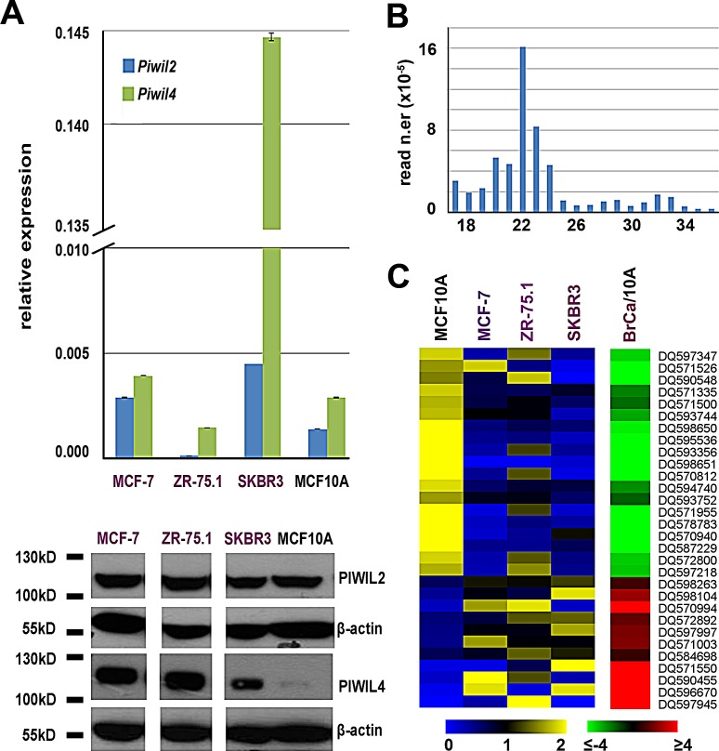
Individual piRNAs in cancer
piRNAs differentially expressed in breast cancer cell lines.
Hashim et al. RNA sequencing identifies specific PIWI-interacting small non-coding RNA expression patterns in breast cancer. Oncotarget. 2014 Oct; 5(20): 9901–9910.

Slide 22
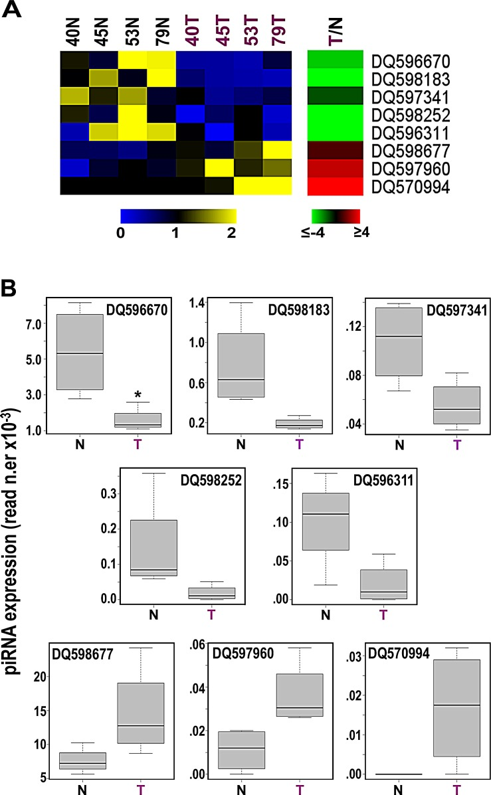
Individual piRNAs in cancer
piRNAs differentially expressed in breast cancer in different patients.
Hashim et al. RNA sequencing identifies specific PIWI-interacting small non-coding RNA expression patterns in breast cancer. Oncotarget. 2014 Oct; 5(20): 9901–9910.

Slide 23
Individual piRNAs in cancer
piR-823 was significantly down-regulated in gastric cancer tissues
piR-651, was significantly up-regulated in gastric cancer
Downregulation of piR-017061, a piRNA that is located within the sno-HBII-296A snoRNA was observed in pancreatic cancer (Müller et al. 2015 Next-generation sequencing reveals novel differentially regulated mRNAs, lncRNAs, miRNAs, sdRNAs and a piRNA in pancreatic cancer. Mol Cancer. 2015 Apr 25;14(1):94.)

Slide 24
Questions in piRNA role in cancer
Are piRNAs ectopically expressed in cancer? While PIWI protein expression in cancer is quite extensively documented, piRNAs have been detected in a handful of cases.
Which genes are regulated by piRNAs and PIWI proteins in cancer?
Is the ectopic expression of PIWI proteins and piRNAs driving cancer development and progression?

Slide 25
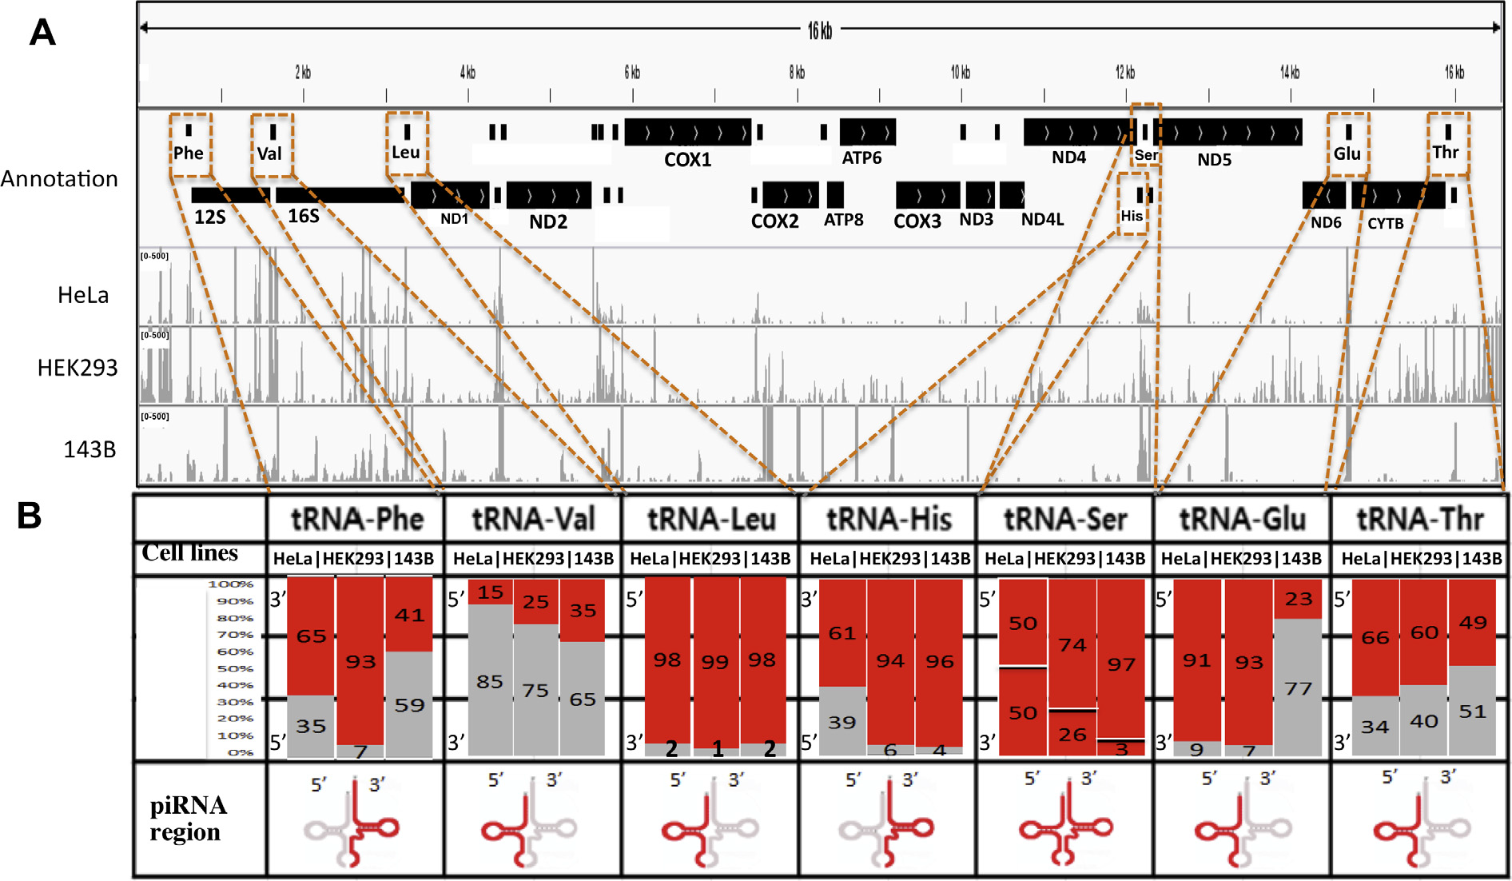
29 piRNA sequence alignments from various regions of the human mitochondrial genome were identified. Twelve out 29 piRNA sequences matched stem-loop fragment sequences of seven distinct tRNAs.
Kwon C, Tak H, Rho M, Chang HR, Kim YH, Kim KT, Balch C, Lee EK, Nam S. Detection of PIWI and piRNAs in the mitochondria of mammalian cancer cells. Biochem Biophys Res Commun. 2014 Mar 28;446(1):218-23. doi: 10.1016/j.bbrc.2014.02.112.

Slide 26
it is possible that mitochondrial Piwi and tRNA-generated
piRNAs could contribute to cellular injury repair mechanisms.

Slide 27
IV. miRNAs in cancer

Slide 28
Nucleus
DNA
pri-miRNA
Drosha-
DGCR8
pre-miRNA
ADAR
Exportin-5
Drosha-
DGCR8
pri-miRNA
*
*
*
*
Dicer/
dsRBD
AGO1
miRISC
pri-miRNA
Nuclear migration
AGO1
AGO1
Cytoplasm
P body
miRNA biogenesis

Slide 29
Mirtrons as a novel concept of miRNA biogenesis
DNA
Exon
Exon
Exon
pre-mRNA
Intron
Intron
Splicing
RNA folding
Drosha
Lariats
phosphor-diester
bond
Processing
by Drosha
hDBR1
RNA re-folding
Degraded
Exportin-5
Dicer
Dicer
RISC

Slide 30
microRNAs in cancer
Overview
microRNAs as oncogenes
microRNAs as tumor suppressors
microRNAs as diagnostic and prognostic markers in cancer
microRNAs and metastasis

Slide 31
1. Overview
As mentioned before, miRNAs are small non-coding RNA molecules, play important roles in cell proliferation, differentiation, and apoptosis;
So, the precise regulation is absolutely required for their normal function.
Mechanisms involved in miRNA regulation are not completely understood yet. However, epigenetic and molecular biological events may play crucial roles in this process.
- Epigenetic factors, DNA methylation and histone modifications;
- Molecular biological factors, transcription factors and proteins involved in miRNA biogenesis.

Slide 32
A large body of evidence has demonstrated that dysregulation of miRNAs contributes significantly to tumorigenesis, angiogenesis and metastasis;
Those miRNAs can function as either tumor suppressor or oncogene.

Slide 33
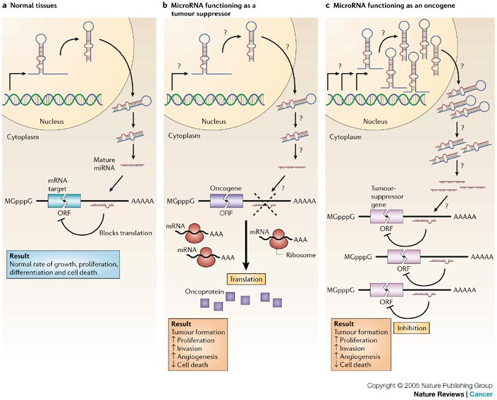


OncomiR
Suppressor
miRNA
Esquela-Kerscher et al.Nature Reviews Cancer6, 259–269 (April 2006) | doi:10.1038/nrc1840

Slide 34
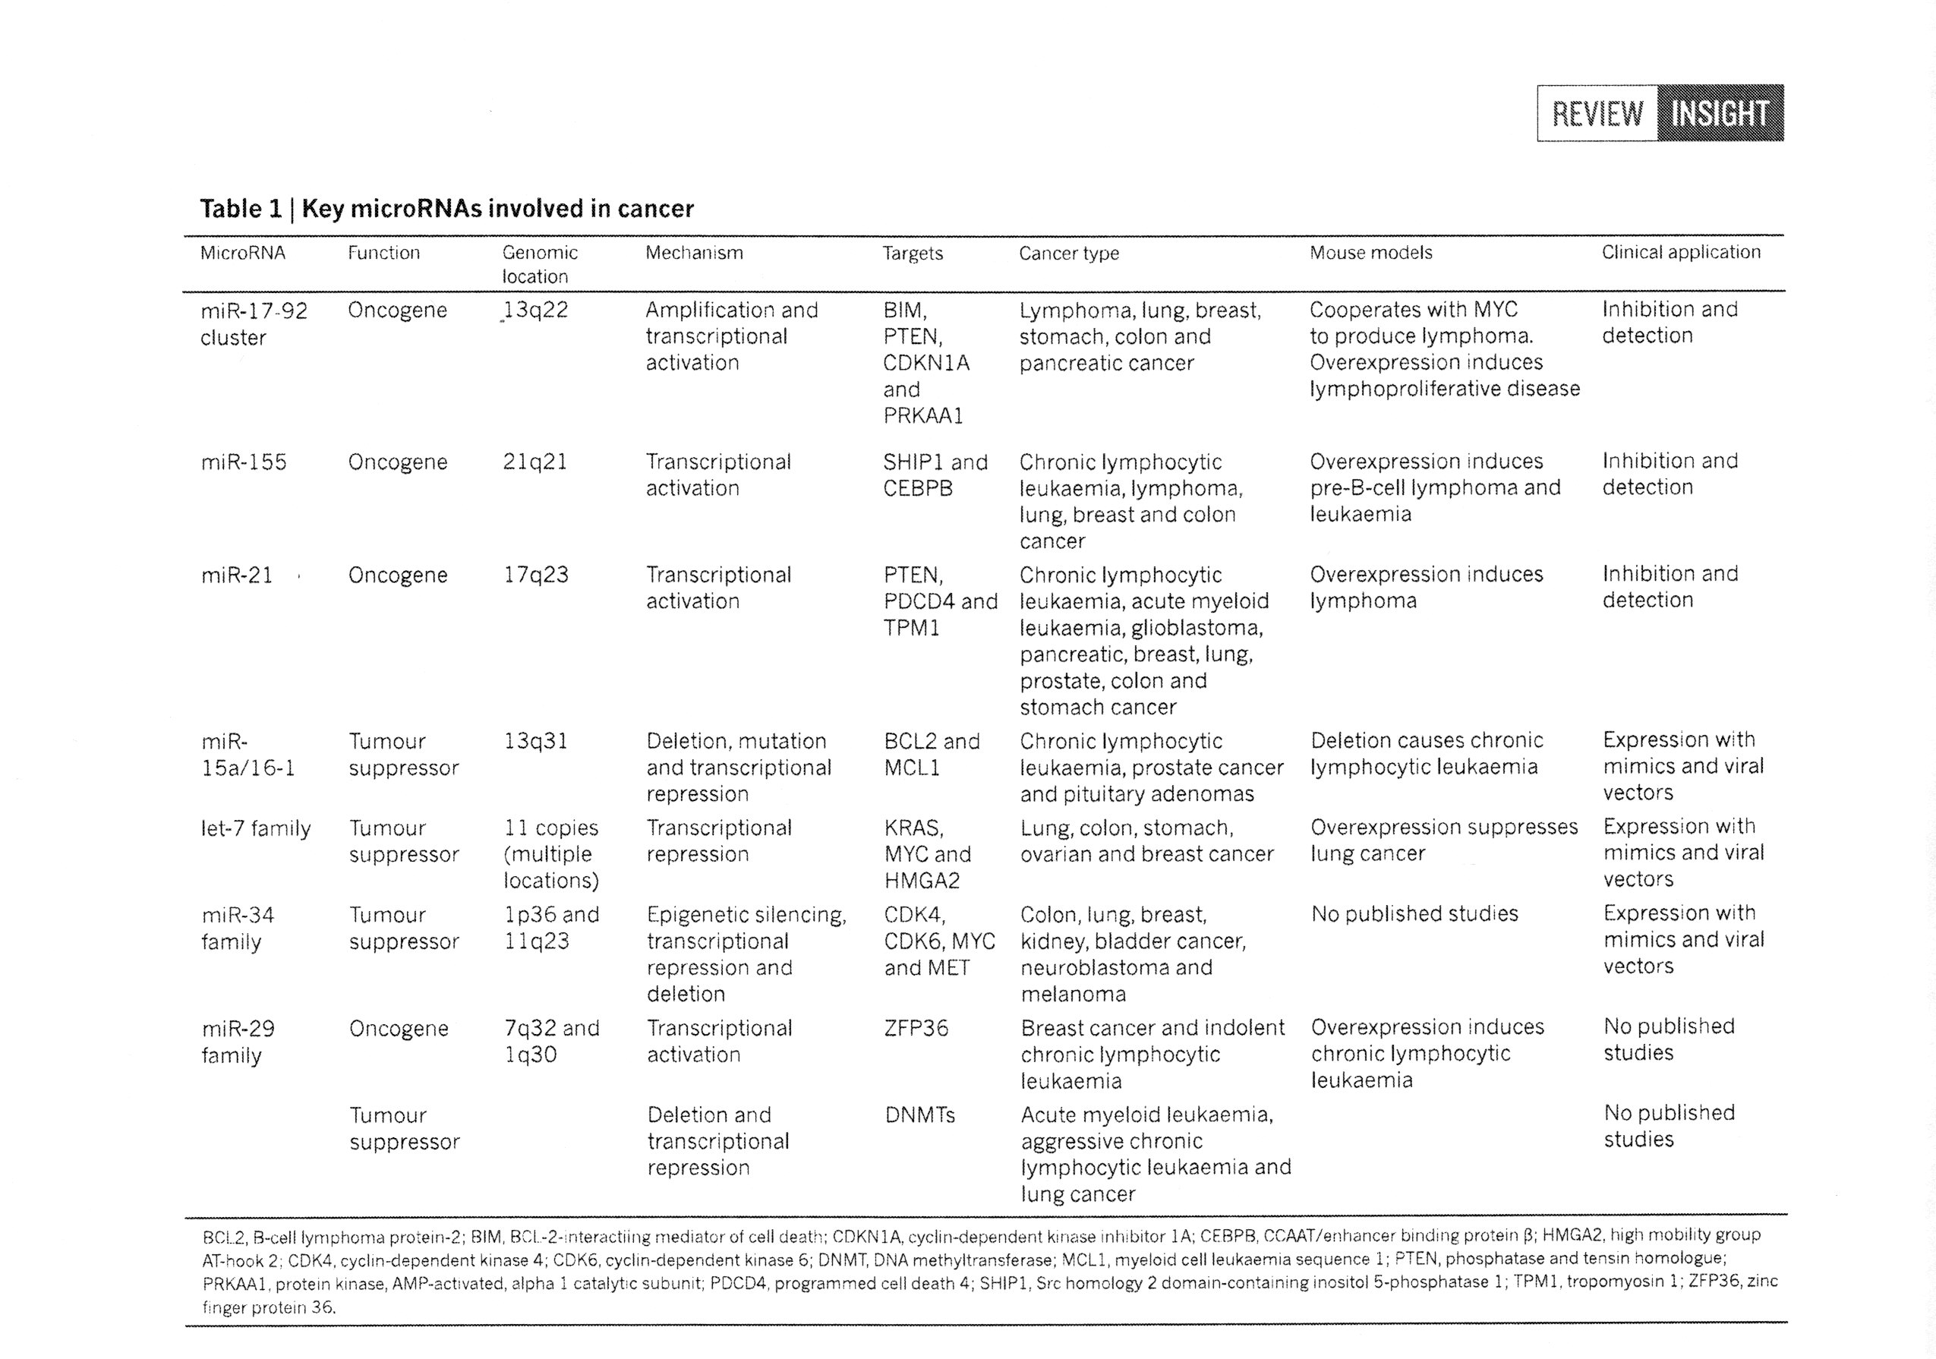

Slide 35
2. miRNAs as oncogenes
The most abundant cancer-related oncomiR is miR-21.
It is upregulated in more than 15 different cancers, including some of the most aggressive cancers, such as glioblastoma, lymphoma, pancreatic and lung cancers.
It is located at chromosome 17 and is regulated by active STAT3.
It silences tumor-suppressor genes PTEN (Phosphatase and Tensin Homolog) and PDCD (Programmed Cell Death gene).

Slide 36
Example: OncomiR-miR-20b
miRNA-20b (miR-20b) is encoded by the miR-106a-363 cluster which, together with the miR-17-92 and miR-106b-25 clusters, forms a large family of highly similar miRNAs called the miR-17 family (Tanzer and Stadler, J Mol Biol 2004 ).
Members of the miR-17 family are often upregulated in many human malignancies, such as lung cancer and leukemias (Hayashit, et al, Cancer Res 2005; Landais, et al, Cancer Res 2007).
The high expression levels of miR-20b in gastric cancer constitute a negative survival prognostic factor (Katada, et al, Int J Oncol 2009).
miR-20b is upregulated in c-Myc-induced mouse mammary tumors (Sun, et al, Breast Cancer Res Treat 2009).
Furthermore, several lines of evidence demonstrated that miR-20b downregulates ERα (Estrogen receptor alpha) (Gastellano et al, PNAS 2009) and modulates VEGF expression by targeting HIF-1α and STAT3 (Cascio, et al, J Cell Physiol 2010) in MCF7 breast cancer cells.

Slide 37
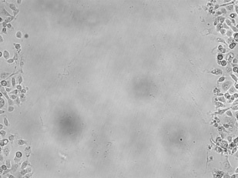
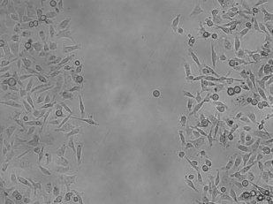
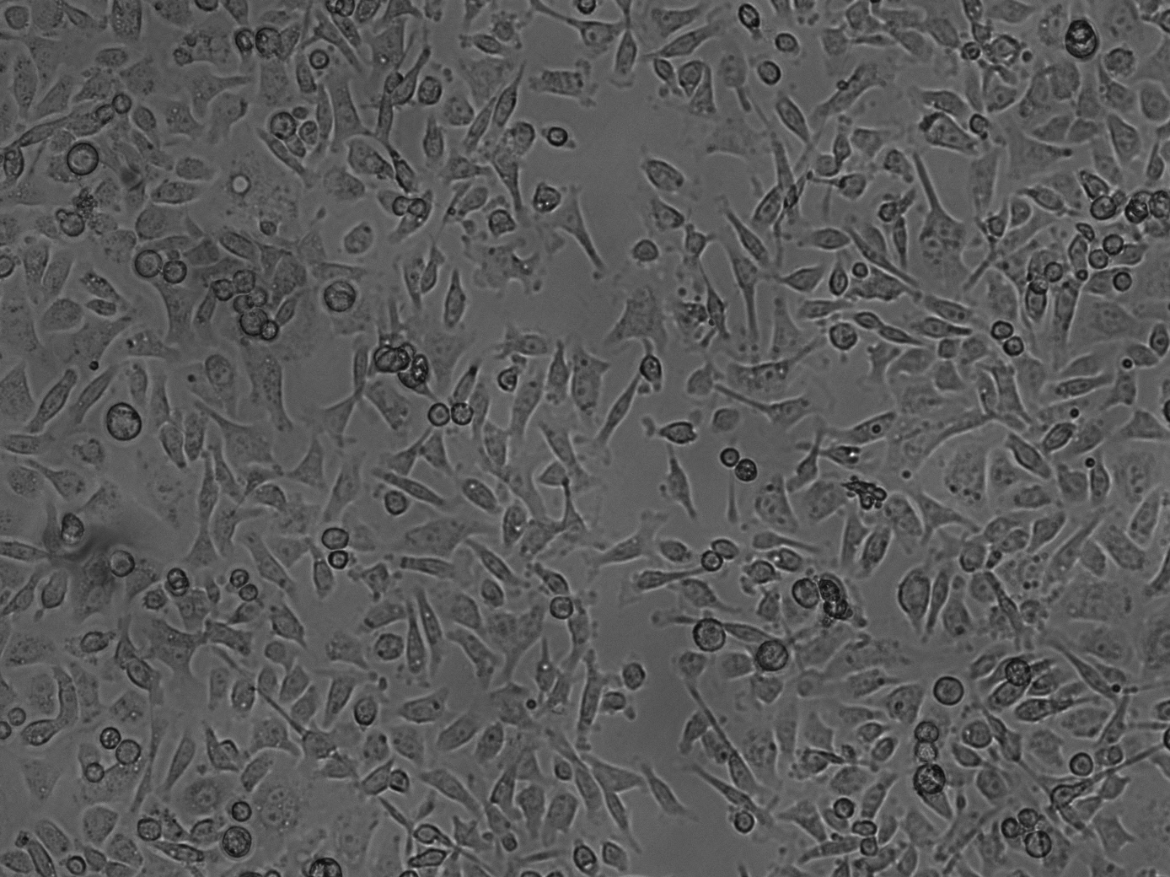
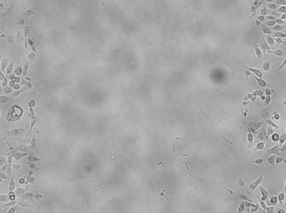
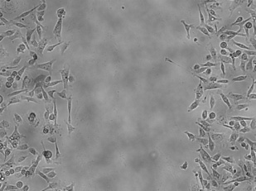
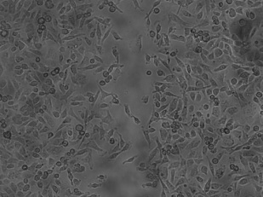
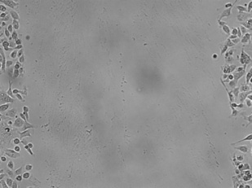
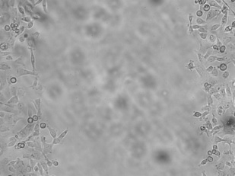
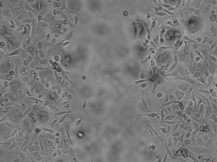
A
*
B
*
Relative expression of has-
miR20b (qRT-PCR)
Cell growth (MTT)
*
*
*
HMEC MCF7 ZR75-1 HCC1419 HCC1806
Day
C
0h 12h 24h (post-injury)
50 nM
Cntr A
D
*
10 nM
miR-20b
inhibitor
Migrated cells
*
*
100 nM
miR-20b
inhibitor
0h 12h 24h
Time post-wound

Slide 38
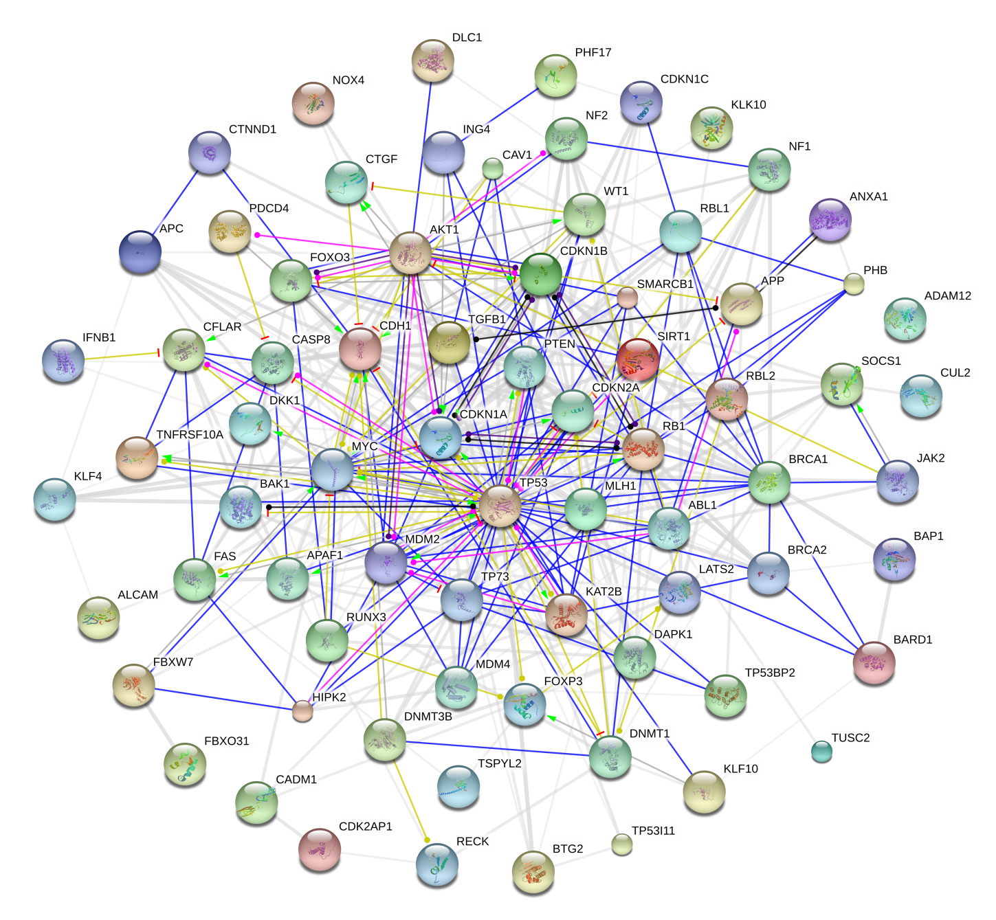
Reaction
Expression
Post-transl. m
Activation
Inhibiton
Phenotype
Binding
miR-20b pulldown and high through-put RNA-Seq
The network was generated using software STRING 9.0

Slide 39
3. miRNAs as tumor suppressors
The most remarkable tumor suppressor miRNAs are members of the let family, the miR-15a-16-1 cluster, the miR-34 family, and the miR-143-145 cluster.

Slide 40
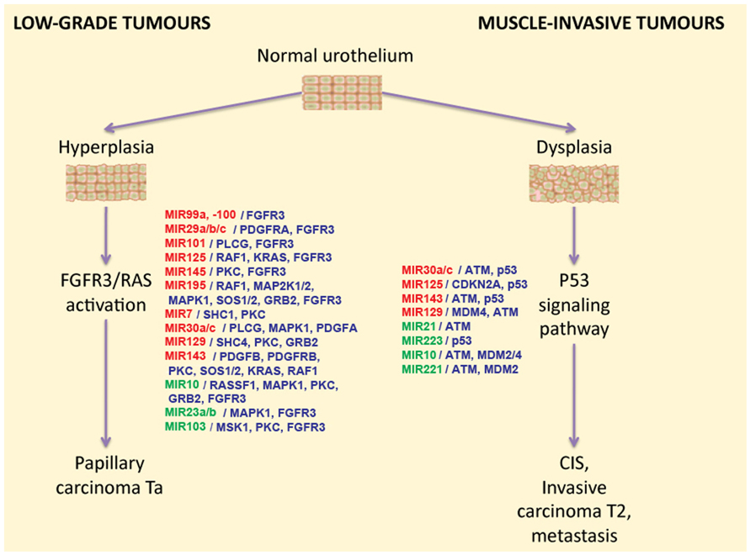
Role of miRNAs in bladder cancer development

Slide 41
4. miRNA and metastasis
Recent progress in cancer research demonstrated an important role of miRNAs in cancer metastasis.
These miRNAs can be classified into metastatic activators and metastatic suppressors
- Metastatic activators, miR-10b, miR-21, miR-127, miR-199a, miR-210, miR-373, and miR-520c.
- Metastatic suppressors, miR-100, miR-126, miR-218, miR-335, and the let-7 family.

Slide 42
5. miRNAs as diagnostic and prognostic markers for cancer
Different tumors and tumor sybtypes have specific miRNA signatures, which might be useful as diagnostic and prognostic markers.
miRNA expression patterns can help distinguish tumor histopathological subtypes and provide signatures for the stage and grade differentiation of tumors.
miRNA profiling of plasma and serum has displayed the potential in diagnosis and prognosis of cancers.

Slide 43
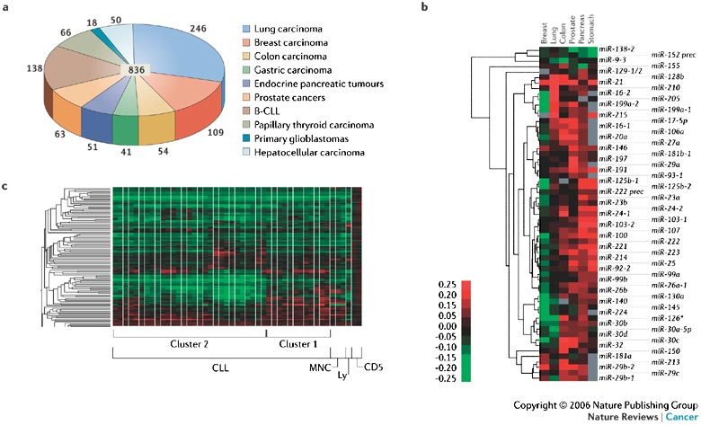
5. miRNAs as diagnostic and prognostic markers for cancer

Slide 44
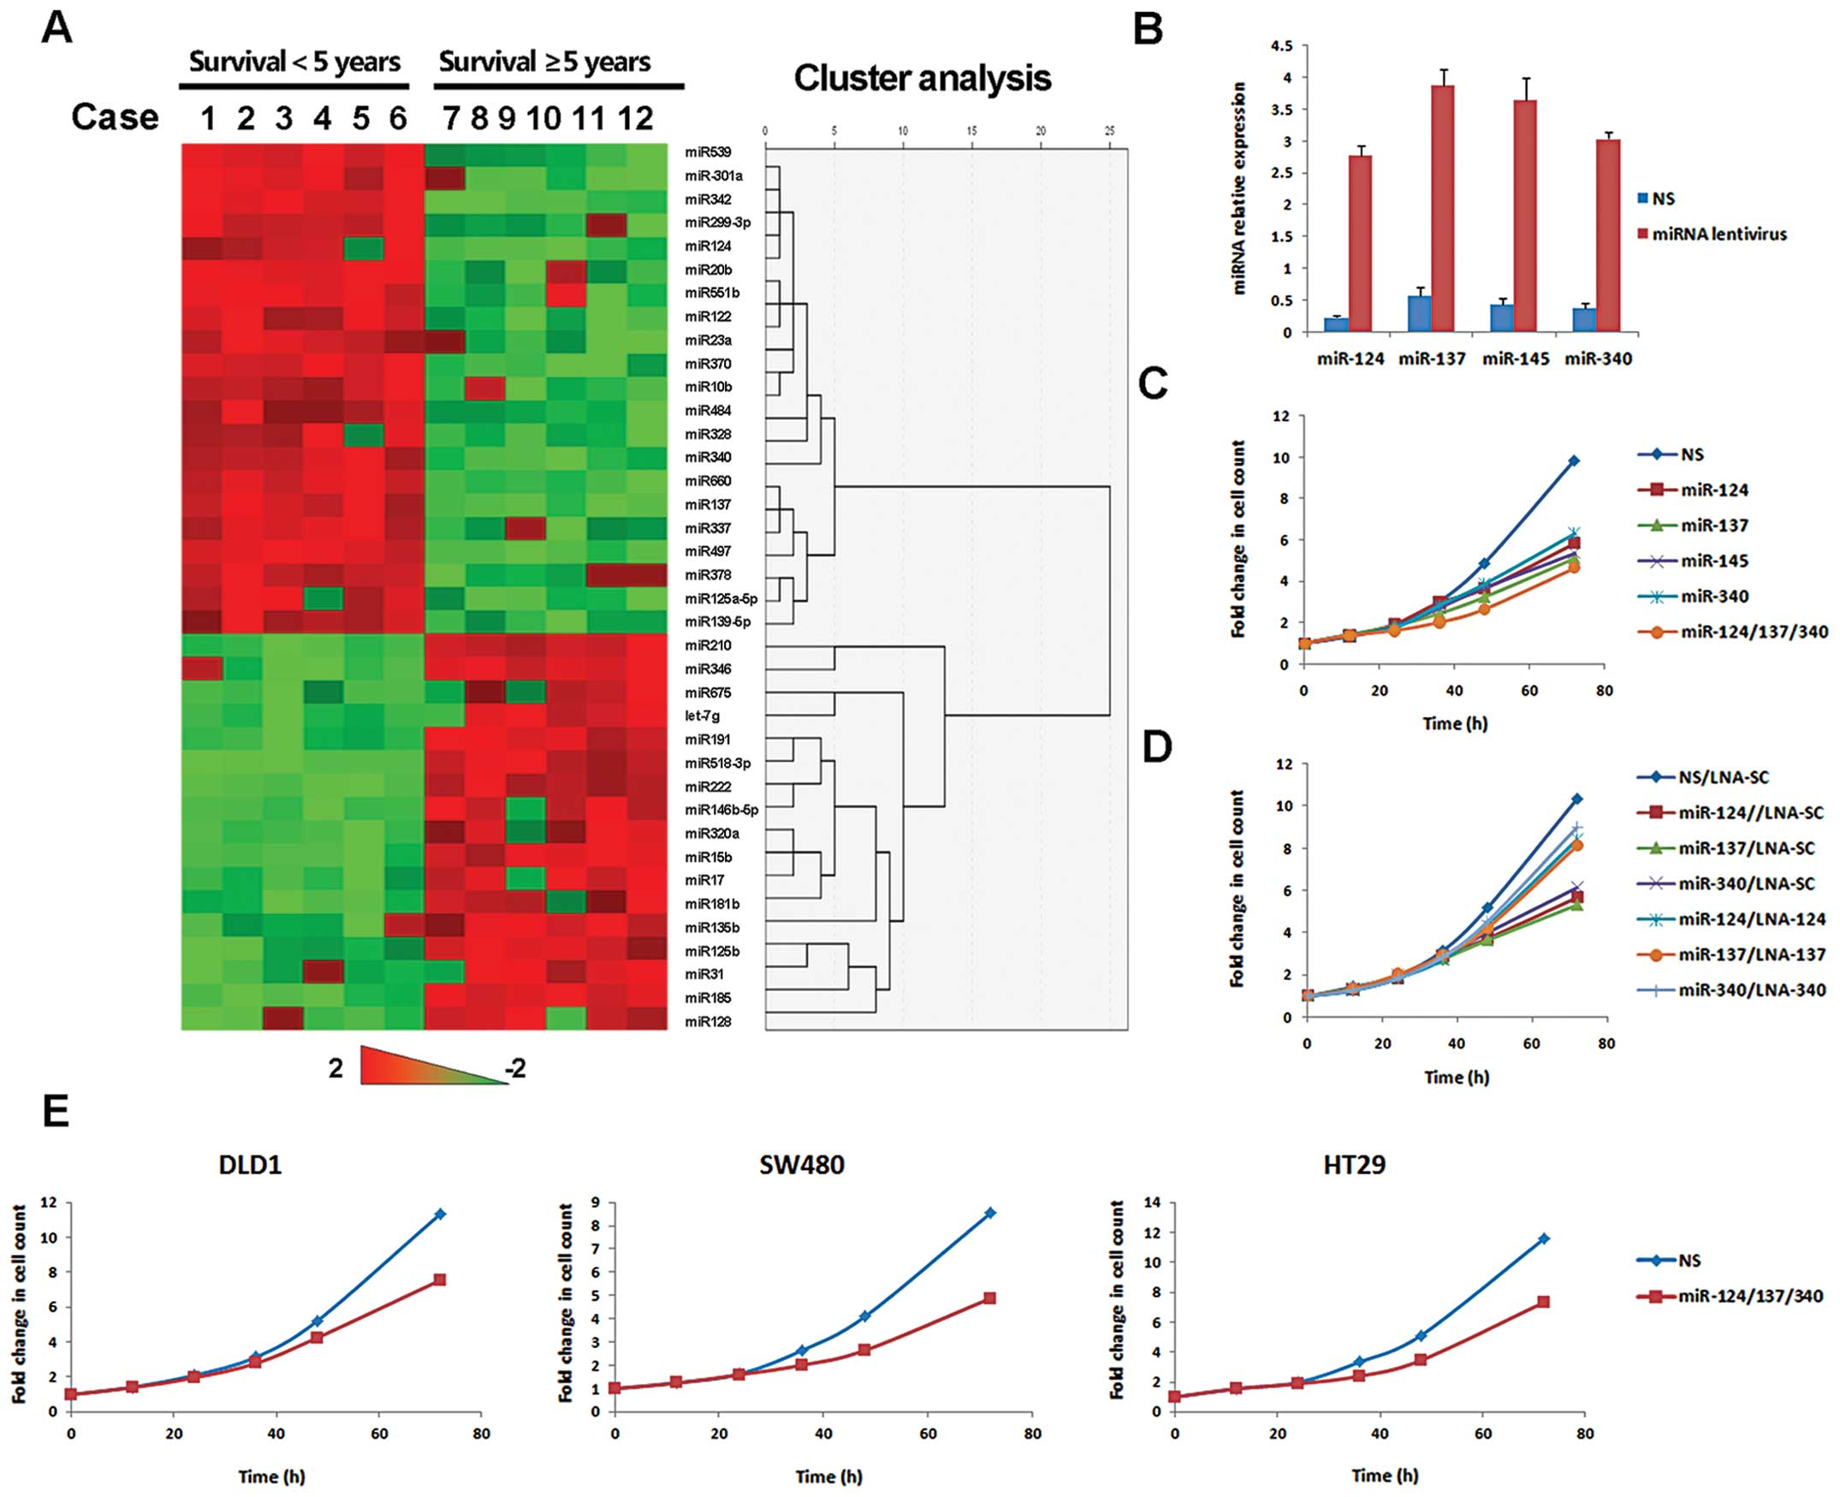
5. miRNAs as diagnostic and prognostic markers for cancer

Slide 45
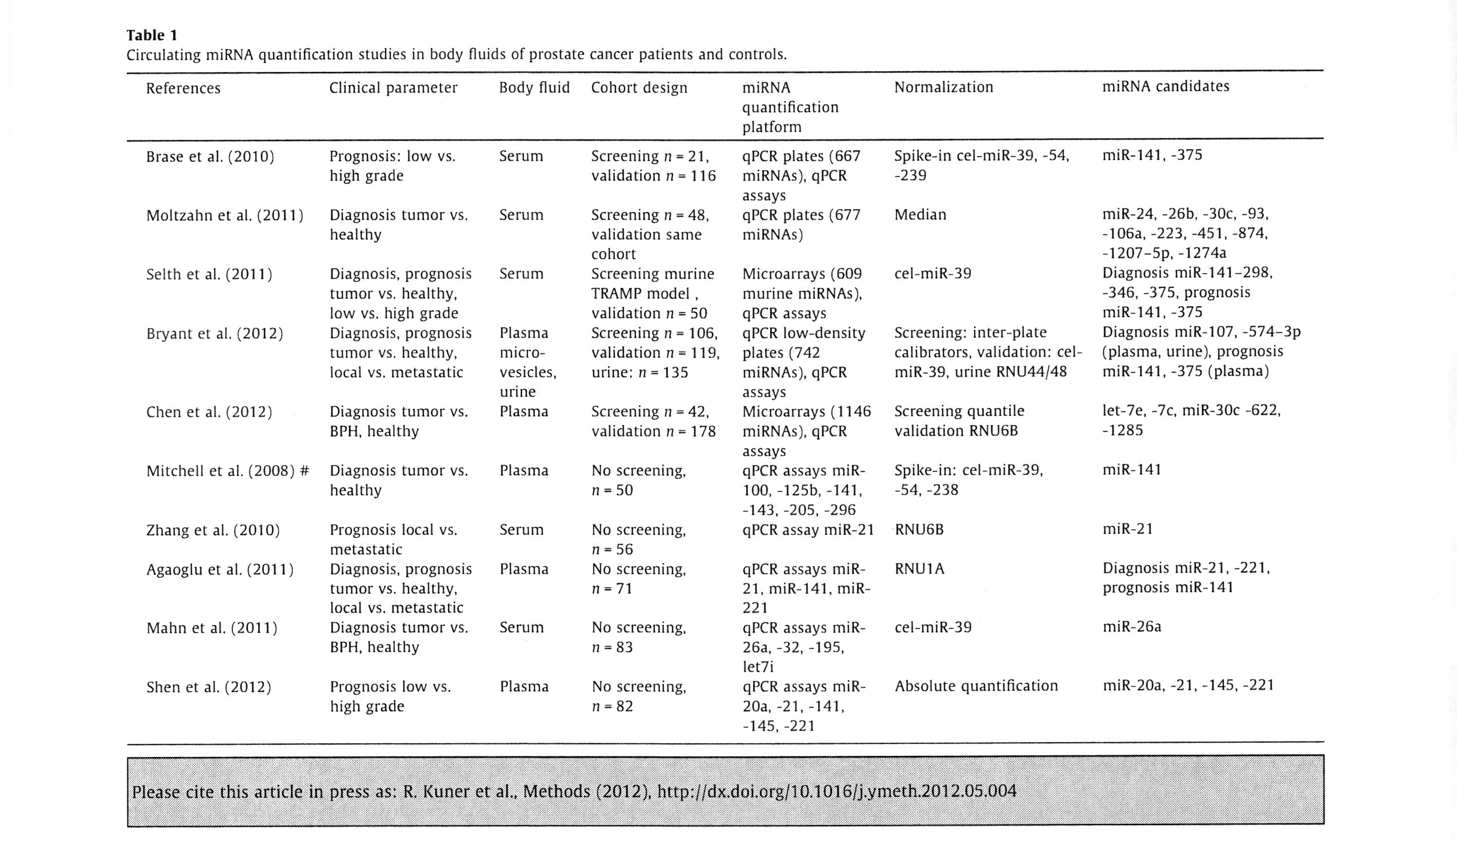

Slide 46
Identification of differentially expressed small non-coding RNAs in a normal vs. tumor comparison

Slide 47
Identification of differentially expressed small RNAs
Analysis step | miRNAs | piRNAs | snoRNAs | snRNAs | rRNAs | tRNAs
Number of unique RNAs profiled (detected with atleast 1 read count) | 1423 | 676 | 768 | 1025 | 459 | 572
RNAs retained after filtering | 126 | 42 | 88 | 22 | 65 | 148
Differentially expressed RNAs (FC>2.0, FDR<0.05) | 80 | 25 | 40 | 6 | 46 | 76
Up-regulated RNAs | 48 | 8 | 9 | 5 | 42 | 76
Down-regulated RNAs | 32 | 17 | 31 | 1 | 4 | 0

Slide 48
miRNAs | Fold change in NGS
hsa-miR-574-3p | -5.8
hsa-miR-99b-5p | -2.33
hsa-miR-769-5p | -1.3
*
*
*
* = p < 0.05

Slide 49
Results miRNAs significant for Overall Survival
miRNA ID | Univariate Cox p-value | Permuted p-value | Fold change and direction
hsa-miR-15a-5p | 0.02 | 0.03 | 12.16 (Up- in tumor)
hsa-miR-660-5p | 0.03 | 0.04 | 12.89 (Up- in tumor)
hsa-miR-574-3p | 0.08 | 0.07 | -5.78 (Down- in tumor)
hsa-miR-27a-3p | 0.06 | 0.07 | 6.46 (Up- in tumor)
Notes:
Mir-660, mir-574, mir-374, mir-196 = novel for bc

Slide 50
miRNAs significant for Recurrence Free Survival
miRNA ID | Univariate Cox p-value | Permuted p-value | Fold change and direction
hsa-miR-193b-3p | 0.09 | 0.09 | -4.33 (Down-regulated in tumor)
hsa-miR-15a-5p | 0.08 | 0.1 | 12.16 (Up-regulated in tumor)

Slide 51
6. Hypermethylation of miRNA genes
Epigenetic silencing of tumor suppressor miRNAs by CpG island hypermethylation is emerging as a common hallmark of cancers.
Among the miRNAs that are reactivated by DNA demethyalting agents, miR-148a, miR-34b/c, and miR-9 were found to undergo specific hypermethylation-associated silencing in cancer cells compared with normal tissues.
The reintroduction of miR-148a and miR-34b/c in cancer cells with epigenetic inactivation inhibited cancer cell motility, reduced tumor growth, and inhibited metastasis formation in xenograft models, with an associated down-regulation of the miRNAoncogenic target genes, such as C-MYC, E2F3, CDK6, and TGIF2.

Slide 52
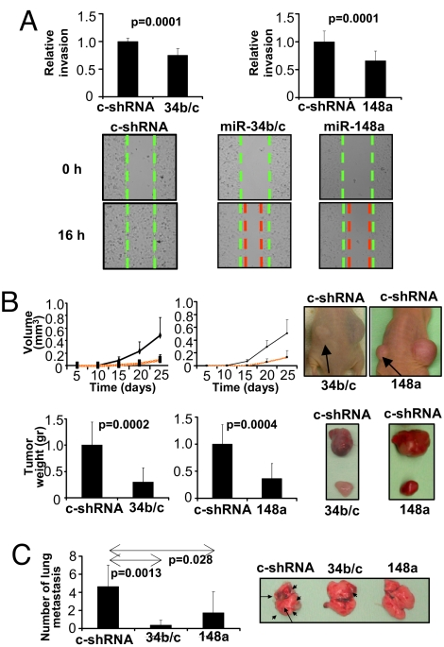
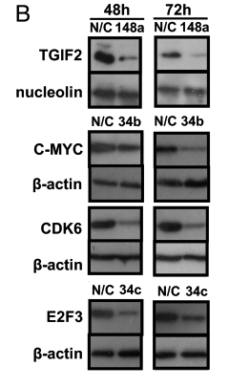
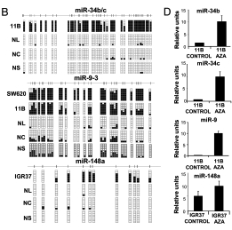
Bisulfite genomic sequencing analysis
In normal tissue and metastatic cell lines
Lujambio A, et al. A microRNA DNA methylation signature for human cancer metastasis. PNAS 105,
13556-61 (2008).

Slide 53
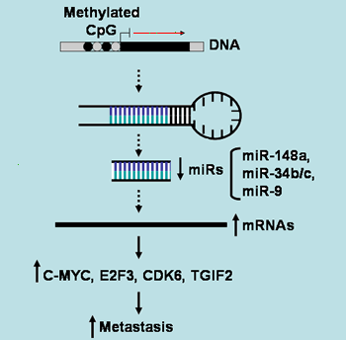
Adapted from MicroRNAs,http://www.epigenetics.ch/mirna.html

Slide 54
V. The story of tumor suppressor-miR-34a
miR-34a belongs to a family of evolutionarily conserved microRNAs, which includes other two members, miR-34b and c, with single, recognizable orthologues in several invertebrate species (He et al., Nature 2007);
A direct transcriptional target of tumor suppressor p53 (Chang et al., Mol Cell 2007; Raver-Shapira et al., Mol Cell 2007);
Plays a crucial role in p53-mediated biological processes, such as cell cycle arrest, apoptosis and senescence, through directly silencing target genes associated with cell cycle control and proliferation, such as cyclin E2, CDK4/6, MET, Notch and E2F (He et al., Mol Cell 2007; Li et al., Cancer Res 2009;Tazawa et al., PNAS 2007);
Inactivation of miR-34a by aberrant CpG methylation has been indicated in human malignancies (Lodygin et al., Cell Cycle 2008; Vogt et al., Virchows Arch 2011).

Slide 55
A
B
*
*
*
*
*
*
*
*
*
*
*
*
In further investigations of the roles of small RNAs in IR responses, we found that IR-induced miR-34a expression was inversely correlated with the levels of tRNA^{Met(CAT)} (A).

Slide 56
A
B
*
*
*
*
*
*
*
*
*
*
*
*
miR-34a was downregulated in all the breast cancer cell lines examined (B, upper panel), and the levels of tRNA^{Met(CAT)} were elevated in these breast cancer cell lines (B, lower panel).

Slide 57
miR-34a may physically interact with and functionally target tRNA^{Met(CAT)}
A
B
*
*
C
*
*
*
*
*
*
*
*
*
*
To establish the ratio of endogenous miR-34a to tRNA^{Met(CAT)} molecules, we generated standard curves with two variants of Ct value and molecule number.
The ratio of miR-34a to tRNA^{Met(CAT)} molecules ranged from 1:169 to 1:188 in IR-exposed HMECs. This ratio in breast cancer cell lines, however, ranged from 1:7.299 × 10³ to 1:1.745 × 10⁵

Slide 58
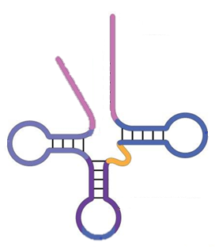
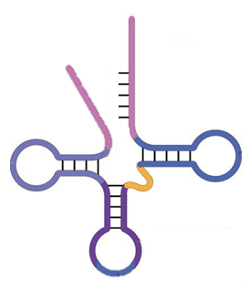
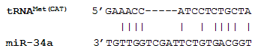
Bioinformatics analysis of binding motif and pull down assay
hsa-miR-34a: uggcagugucuuagcugguugu
rno-miR-34a: uggcagugucuuagcugguugu
mmu-miR-34a: uggcagugucuuagcugguugu
3`
Amino acid
Attachment site
5`
miR-34a
tRNA^{Met(CAT)}
tRNA^{Met(CAT)} was significantly enriched (10-fold) by the wild-type miR-34a probe, while destroying the seed sequence prevented enrichment.
Mature miR-34a sequences in humans, rats, and mice shared 100% identity,
and a potential binding motif for miR-34a and tRNA^{Met(CAT)} was identified in the human sequence

Slide 59
Luciferase translational inhibition assay
*
*
*
*
To further confirm our findings, the seed sequence of tRNA^{Met(CAT)} was inserted downstream of the luciferase 3’UTR.
A dual luciferase assay clearly showed an miR-34a-induced dose-dependent reduction in firefly luciferase activity and tRNA levels in both empty vector and tRNA^{Met(CAT)} reporter.
*
*
*

Slide 60
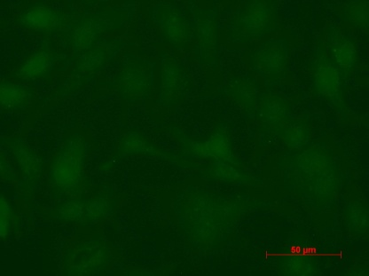
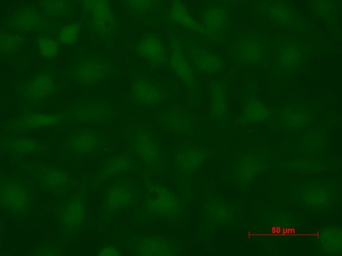
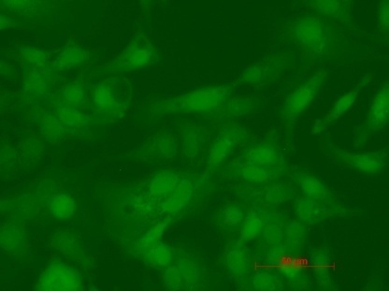
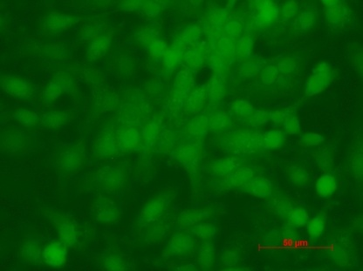
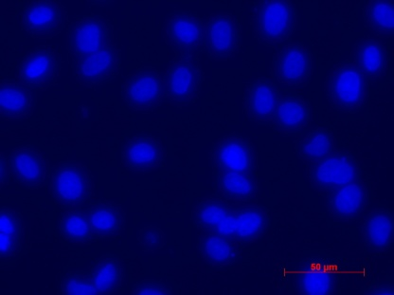
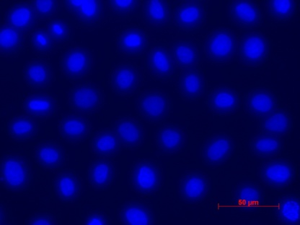
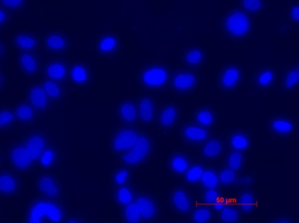
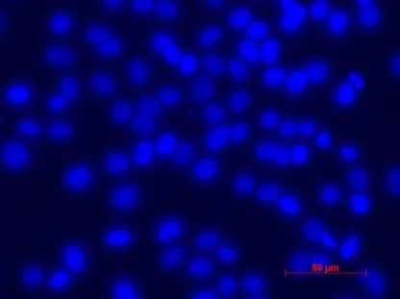
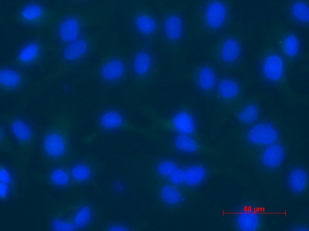
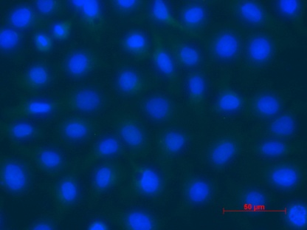
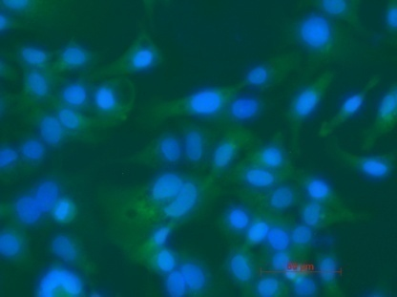
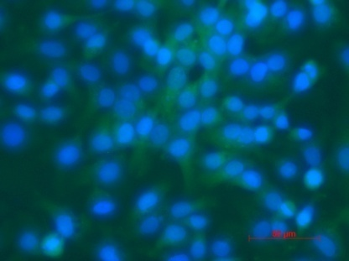
hsa-miR-34a
DAPI
Merge
Dox (-) Dox (+)
To determine whether Ago2 was also involved in miR-34a-directed tRNA^{Met(CAT)} cleavage, we stably transfected HCC1806 cells with a doxycycline (Dox)-inducible hsa-miR-34a plasmid.

Slide 61
Ago2 antibodies enrich miR-34a and tRNA-Met pools
Real-time ChIP RT-PCR indicated that hsa-miR-34a was significantly enriched by anti-Ago2 antibodies (2.5-fold, p=0.043); as expected, tRNA^{Met(CAT)} was also significantly enriched (1.4-fold, p=0.006), although its enrichment was less substantial compared with miR-34a.

Slide 62
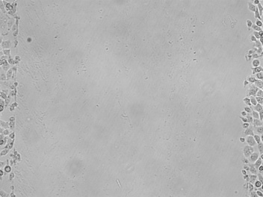
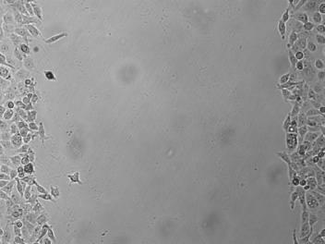
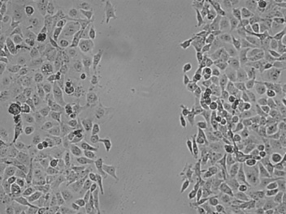
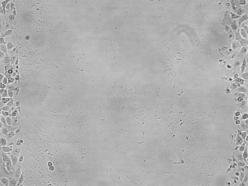
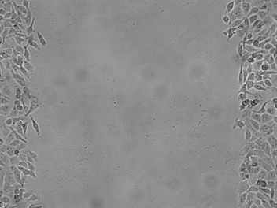
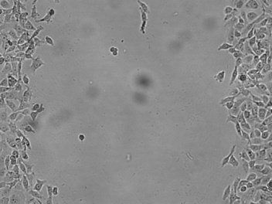
A
B
*
*
*
*
Relative levels of miR-34a
(qRT-PCR)
Relative levels of tRNA^{Met(CAT)}
(qRT-PCR)
Hours post-injury
0 12 24
*
Dox(-)
Dox(+)
We found that miR-34a induced by Dox significantly suppressed breast cancer cell proliferation and migration.
Ectopic miR-34a caused a profound reduction in tRNA^{Met(CAT)}

Slide 63






A
B
*
*
Cell growth (MTT, 595 nm)
Relative levels of miR-34a
(qRT-PCR)
Day post-transfection
C
Hours post-injury
0 12 24
*
Neg control
*
miR-34a
this finding was validated in transient transfection assays using the same parental cell line

Slide 64





D
Ectopic miR-34a substantially induced S-phase cell cycle arrest and apoptosis in the HCC1806 cells.
Dox (-)
*
PE-A
FITC-A
% of early apoptotic cells
Dox(+)
PE-A
FITC-A
E
160
120
Number
80
Dox(-)
40
Dox(-)
*
0 100 200 300 400 500
Channels(PerCP-Cy5-5-A)
160
120
Number
80
Dox(+)
40
0 100 200 300 400 500
Channels(PerCP-Cy5-5-A)

Slide 65




D
Hours post-transfection
24 96
*
PE-A
PE-A
Neg control
1.25%
2.1%
*
FITC-A
FITC-A
PE-A
PE-A
miR-34a
2.3%
3.9%
FITC-A
FITC-A
transient transfection assays confirmed the effect of miR-34a on apoptosis

Slide 66













F
Dox(-)
Dox(+)
VEGF
PLK1
we selectively determined the expression of several validated miR-34a targets, including positive angiogenic regulators (VEGF, Notch1), positive cell cycle regulators (E2F1, CDK6, PLK1), and an anti-apoptotic/survival regulator (Bcl2).
Western blot analysis showed a remarkable reduction in the levels of these proteins in HCC1806 cells inducibly expressing miR-34a.
BCL2
E2F1
DJ-1
NOL1
CTR1
AXL1
14-3-3ζ/δ
TPD52
Notch1
CDK6
Actin

Slide 67




A
Dox(-) Dox(+)
B
Differential spots/2DE
miR-34a Met-shRNA
29 4 32
Upregulated genes
(≧1.7 or p< 0.05)
Control shRNA Met-shRNA
miR-34a Met-shRNA
9 2 27
Downregulated genes
(≦-1.7 or p< 0.05)
We used 2DE/MALDI-TOF analysis to identify six differentially expressed proteins in both HCC1806 cells inducibly expressing miR-34a and tRNA^{Met(CAT)}-knockdown cells. Three proteins were confirmed by Western blotting: 14-3-3 zeta/delta, TPD52 and DJ-1.

Slide 68


G
MCF7/Neg control
Ectopic expression of miR-34a induces apoptosis and G2 arrest
*
*
PE-A
7.1%
FITC-A
MCF7/miR-34a
PE-A
8.9%
FITC-A
H
Next, we evaluated the inducible effect of ectopic miR-34a on apoptosis and cell cycle arrest in another breast cancer cell line, MCF7.
Flow cytometry analyses showed a modest but significant induction of apoptosis and G2 arrest in MCF7 cells transfected with miR-34a
400
300
Negative
control
Number
200
100
0
0 30 60 90 120 150
Channels(PE-A)
*
360
270
miR-34a
Number
180
90
0
0 30 60 90 120 150
Channels(PE-A)

Slide 69
Stable tRNA^{Met(CAT)}-knockdown inhibits cell growth
A
*
Next, we generated a stable tRNA^{Met(CAT)}-knockdown HCC1806 cell line to explore the role of tRNA^{Met(CAT)} in the development of breast cancer and
to establish whether the biological effects of miR-34a are mediated by the targeting of tRNA^{Met(CAT)}.
As expected, knockdown of tRNA^{Met(CAT)} attenuated cell proliferation.
B
*

Slide 70





Stable tRNA^{Met(CAT)} knockdown induces apoptosis
C
Control shRNA
*
PE-A
FITC-A
Met-shRNA
PE-A
FITC-A
As expected, knockdown of tRNA^{Met(CAT)} induced apoptosis and G1-phase cell cycle arrest
D
280
210
Number
*
140
Control
shRNA
70
0
0 200 400 600 800
PerCP-Cy5-5-A
240
180
Number
120
60
Met-shRNA
0
0 200 400 600 800
PerCP-Cy5-5-A

Slide 71




D
Control shRNA Met-shRNA
280
210
Number
140
Control
shRNA
70
0
0 200 400 600 800
PerCP-Cy5-5-A
240
180
Number
120
60
Met-shRNA
0
0 200 400 600 800
PerCP-Cy5-5-A
Interestingly, aneuploid cells were identified in the tRNA^{Met(CAT)}-knockdown cell line by both fluorescent microscopy and flow cytometry

Slide 72










E
Hours post-injury
0 12 24
*
Control shRNA
*
Met-shRNA
F
Control shRNA Met-shRNA
*
Furthermore, we found that tRNA^{Met(CAT)} knockdown inhibited breast cancer cell migration (E) and colony formation (F).

Slide 73




G
Control shRNA Met-shRNA
*
Furthermore, we found that tRNA^{Met(CAT)} knockdown represses angiogenesis (G)

Slide 74
Overexpreesion of tRNA^{Met(CAT)} dsiRNA inhibits cell proliferation
A
B
*
*
*
We attempted to confirm the data by transiently transfecting HCC1806 cells with either wild-type tRNA^{Met(CAT)} dsiRNA or scrambled tRNA^{Met(CAT)} dsiRNA.
The qRT-PCR showed that wild-type tRNA^{Met(CAT)} dsiRNA significantly reduced the levels of tRNA^{Met(CAT)}, while the scrambled tRNA^{Met(CAT)} dsiRNA had no significant effect (A).
The MTT assay indicated a remarkable reduction in cell proliferation induced by wild-type tRNA^{Met(CAT)} dsiRNA, while this reduction was completely abolished by scrambled tRNA^{Met(CAT)} dsiRNA (B).

Slide 75








Protein expression levels of a panel of validated miR-34a targets in cell line with tRNA^{Met(CAT)} knockdown
Control shRNA
Met-shRNA
VEGF
PLK1
Western blot analyses revealed that tRNA^{Met(CAT)} knockdown functionally attenuated the expression of positive angiogenic regulators (VEGF, TGFβ1), positive cell cycle regulators (E2F1, PLK1), anti-apoptotic/survival regulators (Bcl2, Raf1), and two methionine-rich proteins (NOL1 and CTR1).
Knockdown of tRNA^{Met(CAT)} also elevated the expression of cleaved caspase-3 and Notch1.
NOL1 and CTR1 were also downregulated upon overexpression of miR-34a.
BCL2
E2F1
DJ-1
NOL1
CTR1
Cleaved Casp-3
Notch1
RAF1
14-3-3ζ/δ
RPLP2
TGFβ1
Actin

Slide 76
tRNA^{Met(CAT)} knockdown inhibits protein synthesis
A
*
Relative levels of tRNA^{Met(CAT)}
(qRT-PCR)
As tRNA^{Met(CAT)} is a component of the protein synthesis machinery, its knockdown via shRNA should repress global protein synthesis, which is indeed what we observed
B
*
Protein concentration (pg/cell)

Slide 77


I
J
*
*
K
*
240
400
180
300
Number
Control shRNA
Number
Met-shRNA
*
120
200
60
100
0
0
0 100 200 300 400 500
Channels(PerCP-Cy5-5-A
0 100 200 300 400 500
Channels(PerCP-Cy5-5-A)
As additional validation of our findings, we stably transfected MCF7 cells with the same shRNA vectors targeting tRNA, revealing a similar reduction in cell proliferation (I and J), induction of G1 arrest (K).

Slide 78


L
MCF7/Control shRNA
*
4.7%
PE-A
2.4%
FITC-A
MCF7/Met-shRNA
*
16%
PE-A
9.5%
FITC-A
As additional validation of our findings, we stably transfected MCF7 cells with the same shRNA vectors, revealing a similar induction of apoptosis (L).

Slide 79
The expression of ectopic tRNA^{Met(CAT)} enhanced cell growth (A and B)
A
B
*
*
Notes:
the expression of ectopic tRNA^{Met(CAT)} enhanced cell growth (Fig. 5A and B), inhibited apoptosis (Fig. 5C), and accelerated the S/G2 transition (Fig. 5D).

Slide 80


The expression of ectopic tRNA^{Met(CAT)} inhibited apoptosis (C), and accelerated the S/G2 transition (D)
C
HCC1806/pcDNA
PE-A
*
1.8%
FITC-A
HCC1806/tRNA-Met
PE-A
1.3%
FITC-A
D
500
400
300
pcDNA
*
Number
200
100
0
0 20 40 60 80 100 120
Channels(PE-A)
500
400
300
tRNA-Met
Number
200
100
0
0 20 40 60 80 100 120
Channels(PE-A)
Notes:
the expression of ectopic tRNA^{Met(CAT)} enhanced cell growth (Fig. 5A and B), inhibited apoptosis (Fig. 5C), and accelerated the S/G2 transition (Fig. 5D).

Slide 81












Levels of miR-34a and tRNA^{Met(CAT)} in a large-scale breast cancer tissue array
A
miR-34a DAPI tRNA^{Met(CAT)} DAPI
Normal
Benign
Tumor

Slide 82
B
n=14
n=27
n=142
C
n=16
n=25
n=144

Slide 83
























D
Normal Tumor Normal Tumor Normal Tumor
miR-34a
C1
C3
D1
D3
D5
D7
DAPI
tRNA^{Met(CAT)}
C1
C3
D1
D3
D5
D7
DAPI
Stomach Intestine rectum Kidney
*
*
*
Relative fluorescence intensity
Relative fluorescence intensity
Relative fluorescence intensity
*
*
*
Notes:
Real-time RT-PCR and FISH analyses indicated the same correlation between downregulated miR-34a and elevated tRNA^{Met(CAT)} in an immortalized erythroid cell line (RM5), malignant glioma cell lines (M059J and M059K), a neuroblastoma cell line (IMR-32), a colon adenocarcinoma cell line (HT-29), and tissue sections of stomach, rectal, and kidney carcinomas.

Slide 84



A
Figure 7
B
Normal mammary gland
Breast cancer
Nucleus
Pre-miR-34a
Nucleus
Pre-miR-34a
miR-34a gene
miR-34a gene
Cytoplasm
Cytoplasm
Mature miR-34a
Mature miR-34a
tRNA^{Met(CAT)}
CCA─OH
tRNA^{Met(CAT)}
CCA─OH
Normal rate of cell proliferation, differentiation, and apoptosis.
Promotes cell proliferation, migration and angiogenesis; inhibits apoptosis.

Slide 85
A
*
B
*
*
*
*
*
*
*
Relative expression of miR-34a
(qRT-PCR)
Relative expression of tRNA^{Ser}
(qRT-PCR)
It should be pointed out here that in addition to tRNA^{Met(CAT)}, miR-34a may target other tRNAs, such as tRNA^{Ser}.

Slide 86

VI. siRNA nanomedicine

Slide 87
Acknowledgements
Most of the work on miR-34a was done by Bo Wang, Dongping Li and Rocio Rodriguez
miRNA in cancer work - Preethi Krishnan and Sambasivarao Damaraju
Financial Support:
Canadian Breast Cancer Foundation (Olga Kovalchuk)
Canadian Institute of Health Research (Olga Kovalchuk)

